Slide 1
Presentation made by
Aidan Kotsch, Carter Ptak, and Jean Luis Urena
CSCI 630
Solving Killer Sudoku
Notes:
Carter
Title (Title, group names, course, university, date) - done
Carter
Introduction (Problem, background, hypotheses, visuals) - Done
Carter
Discuss problem (visuals!)
We thought that doing more processing to remove extra nodes would be faster than just brute force with backtracking
Methods (Dataset, preprocessing, design, tools, models, architecture, and evaluation method)
Backtracking Arcs Setup + Domains
Jean
What dataset we use as well please (and what it provides? (solution))
Backtracking Modified with Forward Tracking (AC3/MRV/LCS) - needs gifs
Aidan
ML Training/Running - Done
Carter
Train with solutions (random reveal)
Demo/Results (Key findings with clean, labeled figures and metrics)
Aidan
Average time, max/min, nodes
Chart (speed/difficulty)
Results/Conclusions bleed together
Conclusions (Interpretations, comparison, limitations, future works)
Problem is simple enough that adding complexity tends to diminish efficiency
Use heuristics
Jean
Future Works
Everyone (Aidan/Carter)
Cool other Sudoku problems that are even more complicated
Other ML strats we could try
Acknowledgments (Collaborators, references, etc.)
Jean
Dataset

Slide 2
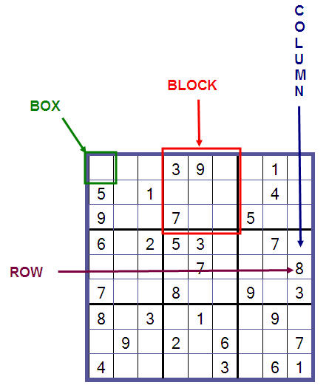
Sudoku
Every Column, Row, and Block needs to have all 9 numbers
Notes:
Carter

Slide 3
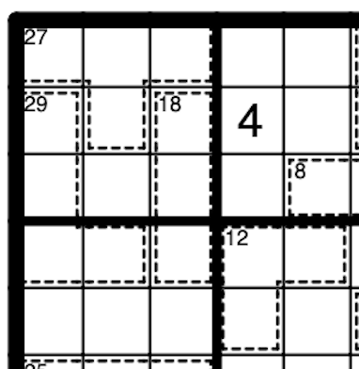
Killer Sudoku
Every Column, Row, and Block needs to have all 9 numbers
The sum of all digits in a cage must add up to the number in the top left of the cage
No repeats in a single cage
Notes:
Carter

Slide 4
Hypothesis
Forward checking will result in a speed up over brute force backtracking.
Notes:
Carter

Slide 5
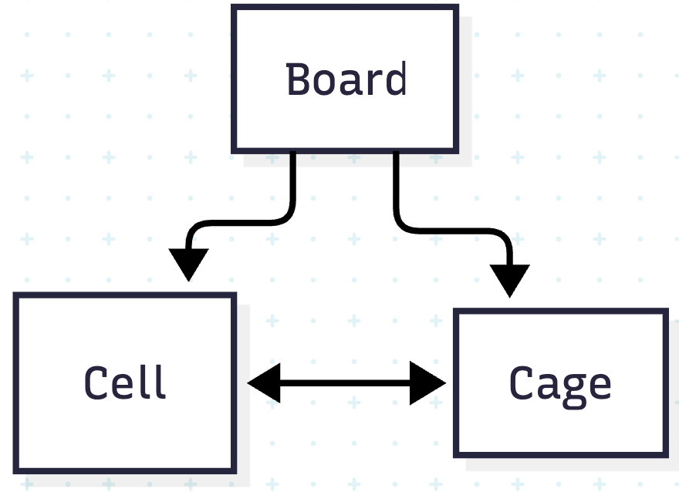
Dataset and Pre-processing
Dataset
Pre-Processing
Killer Sudoku dataset from HuggingFace.
Columns include:
Puzzle
Human Difficulty
Backtrack calls
Dataset was processed into Python objects
Provided better structure
Object references
Objects retained domains
Notes:
JEAN
Object references between cells and cages enable efficient constraint propagation and domain reduction through arc consistency algorithms.
Difficulty rises in correlation with the number and complexity of cages

Slide 6
Pre-processing
Continued – Arcs & Domains
Cage
Domains: All possible numbers that sum up to the target sum
Arcs: Cells point to every other Cell in same cage
Cell
Domains: Cell value 1-9
Arcs: All neighboring Cells (horizontal, vertical, and within 3x3 box)
Notes:
JEAN

Slide 7
Machine Learning Strategy
Hybrid ML
Binary candidate ranker
Given a board state, predict what number is best for this cell
Confirm new setup is valid
If not, backtrack
Notes:
Carter Mention why we didn’t do straight problem -> solution one step

Slide 8
Machine Learning Training
Training
Reveals a sample of “correct” cells from the given solution
Creates a candidate for each possible choice for a single cell
“Correct”, if that candidate matches the hugging face solution
Given the state of the board, and this possible candidate, is this the right digit?
A lot more “wrong” digits than correct ones, so wrong digits are worth less
Notes:
Carter

Slide 9
Backtracking Algorithms
Backtracking
Backtracking Modified
Iterate through each cell choosing next domain value for the cell.
If valid assignment progress and if not backtrack.
Use MRV to assign values to cells with only one valid domain value then use AC3 to reduce the other cells’ domains.
Once no more such cells exist perform backtracking as normal.
Notes:
Aidan

Slide 10
Demo
Notes:
Aidan

Slide 11
Backtracking with Forward Checking
Main issue: LCV has to run for each value in cell selected by MRV.
Notes:
Aidan

Slide 12
Algorithm Times
Difficulty 2 | Backtracking Time | MLP Time | Backtracking Modified Time | Backtrack Modified Saved Backtracks
Average | 1.10 | 0.19 | 0.19 | 113492
Minimum | 0.01 | 0.01 | 0.11 | 502
Median | 0.42 | 0.10 | 0.19 | 41865
Maximum | 6.36 | 1.82 | 0.31 | 661375
Difficulty 3 | Backtracking Time | MLP Time | Backtracking Modified Time | Backtrack Modified Saved backtracks
Average | 2.67 | 3.84 | 0.33 | 252704
Minimum | 0.02 | 0.05 | 0.10 | 740
Median | 1.48 | 0.59 | 0.22 | 129781
Maximum | 9.08 | 156.77 | 1.87 | 900038
Difficulty 4 | Backtracking Time | MLP Time | Backtracking Modified Time | Backtrack Modified Saved backtracks
Average | 3.67 | 33.07 | 0.83 | 252704
Minimum | 0.04 | 0.32 | 0.08 | 2088
Median | 3.16 | 10.83 | 0.49 | 236663
Maximum | 9.21 | 170.48 | 3.81 | 846540
Notes:
Aidan:

Slide 13
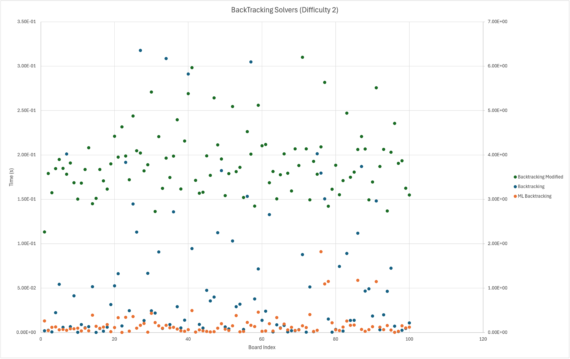
Backtracks Time (Difficulty 2)
Notes:
JEAN Right x-axis is higher (Backtracking & MLP)

Slide 14
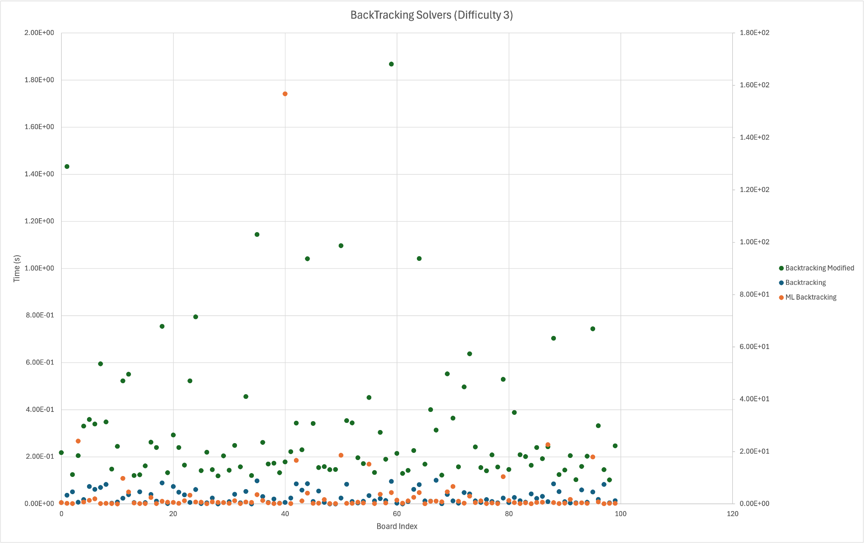
Backtracks Time (Difficulty 3)
Notes:
JEAN Right x-axis is higher (Backtracking & MLP)

Slide 15
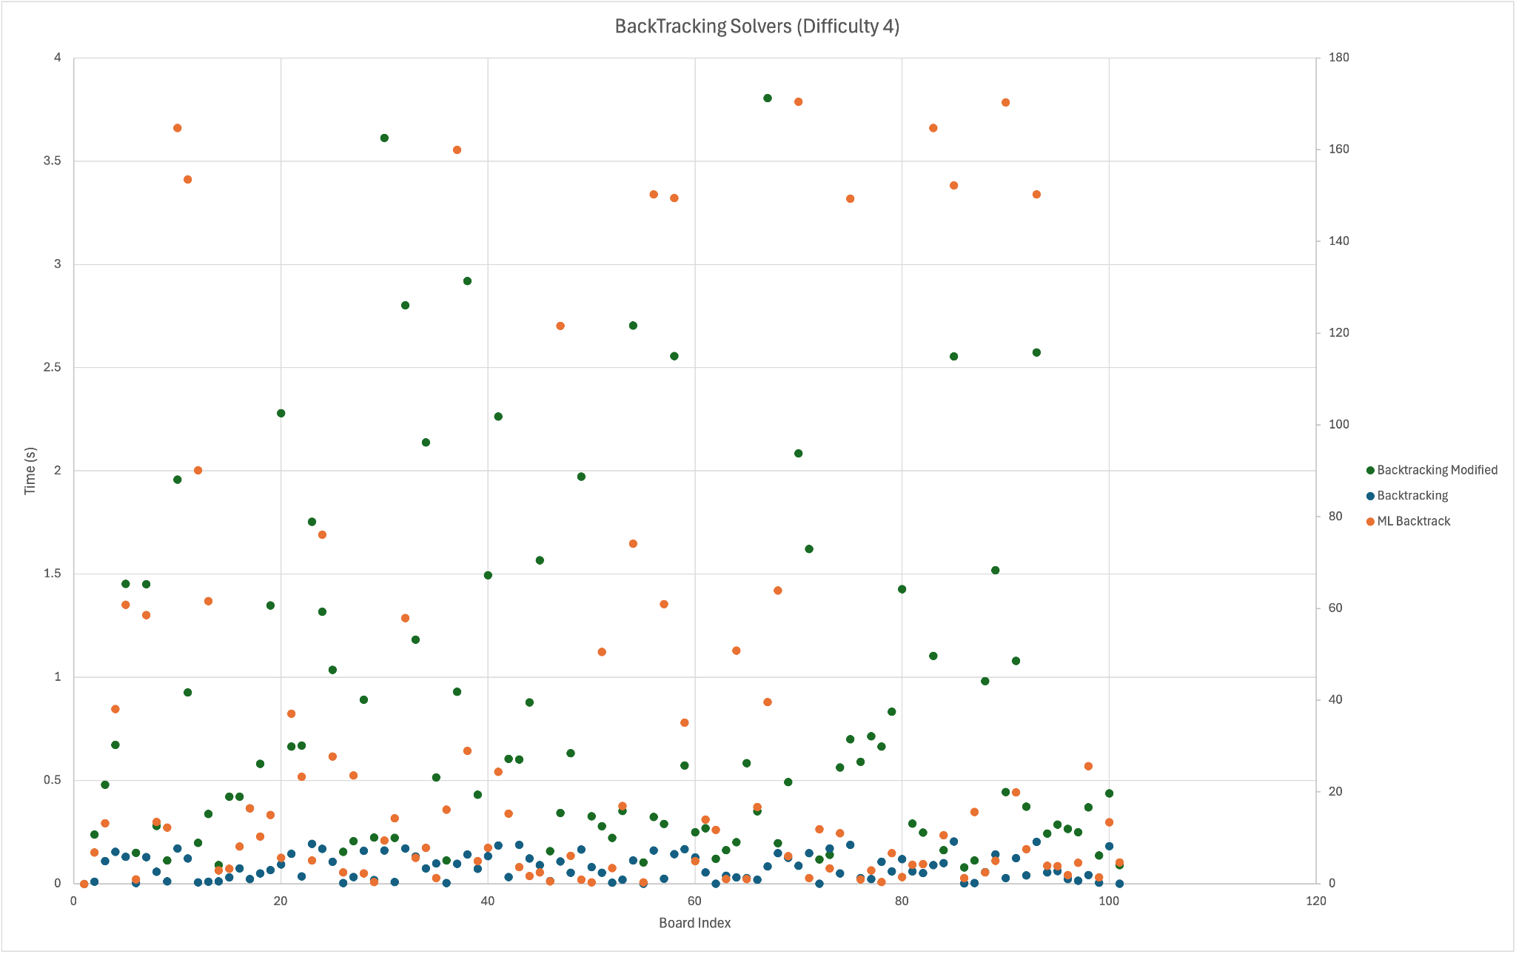
Backtracks Time (Difficulty 4)
Notes:
JEAN Right x-axis is higher (Backtracking & MLP)

Slide 16
Conclusions
LCV adds too much complexity to a problem that can be solved quickly with only backtracking.
Finding a middle ground between using heuristics and not.
MRV and AC3 were useful for limiting the number of values in each domain that backtracking had to iterate through.
ML Heuristic based backtracking performed poorly due to complexity of ML.
Notes:
JEAN

Slide 17
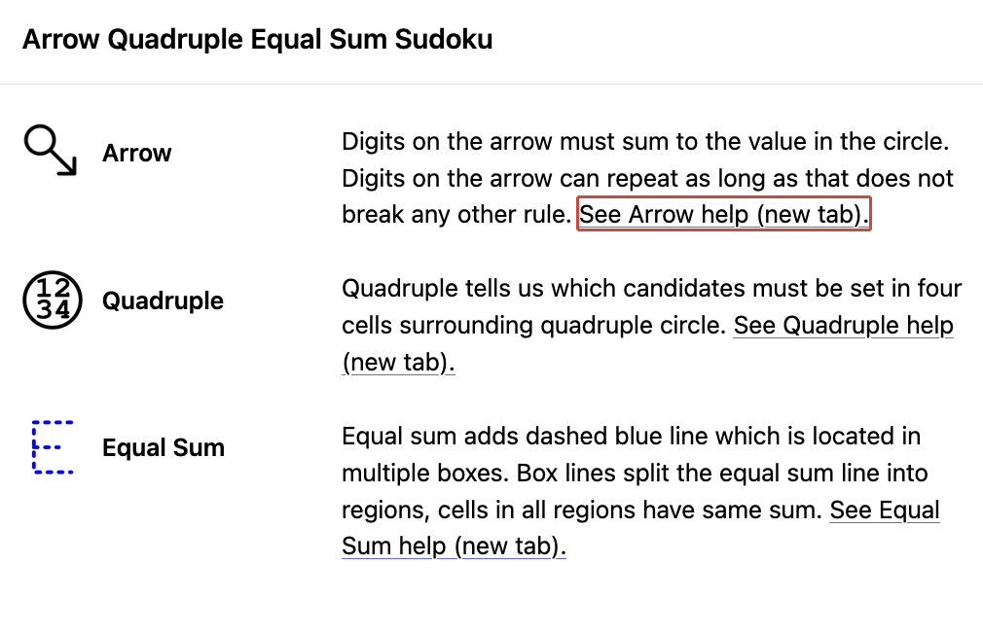
More Complicated Sudoku Problems
Additional rules means less given information.
Forward checking could prove more reasonable than typical backtracking
Notes:
Aidan

Slide 18
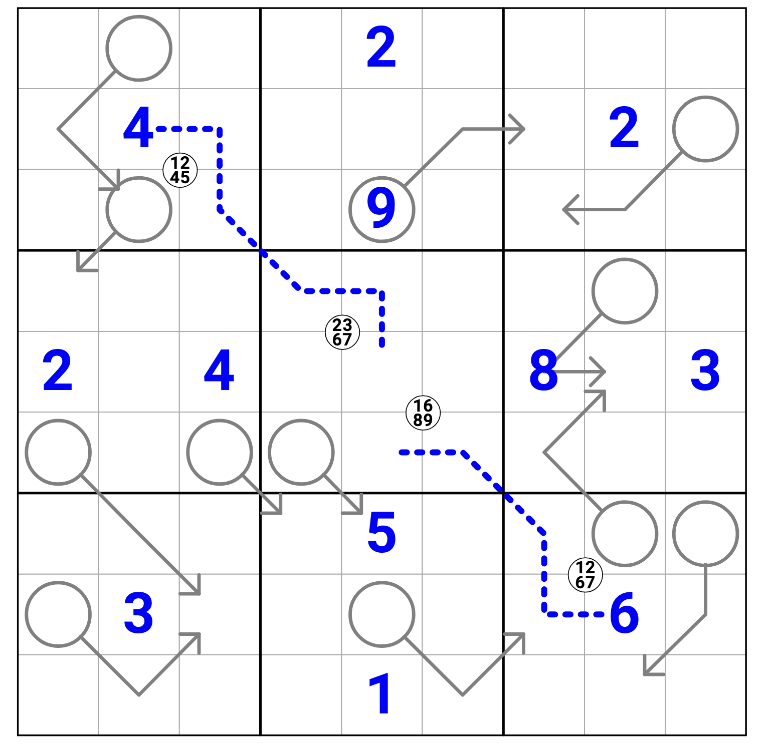
Notes:
Aidan

Slide 19
Acknowledgements and References
Jack Cai for the Killer Sudoku dataset
https://huggingface.co/datasets/jackcai1206/killer-sudoku-puzzles

Slide 20
Thank you!
Questions?

